Slide 1


Probabilistic AI tools applied to Robust Model Predictive Control: A UAV Path Tracking study, OOP C++ Approach
Marcos Vinicius Teixeira Maciel
Guides : Caroline Chanel, Joël Bordeneuve-Guibe

Slide 2
Contents
Problem Statement and Proposal
Studies on Model Predictive Controllers (MPC)
Control and AI – MPCs and Markov Decision Processes (MDP)
Trial-based Heuristic Tree Search (THTS)
Results & Analysis
Conclusion and Perspectives

Slide 3
Problem Statement
This project aims to address the open-ended research problem of using probabilistic AI tools to support the design of Robust Model Predictive Controllers (MPCs) for UAV path tracking.
Proposal
To translate the MPC problem into a Stochastic Shortest Path Markov Decision Process, and to evaluate online solving algorithms to ensure path tracking in the presence of perturbations and uncertainties, in bounded time.

Slide 4
Studies on Model Predictive Controllers (MPC)
MPC with perturbations
Simodrone Implementation
Lessons Learnt
(Previous Semester)

Slide 5
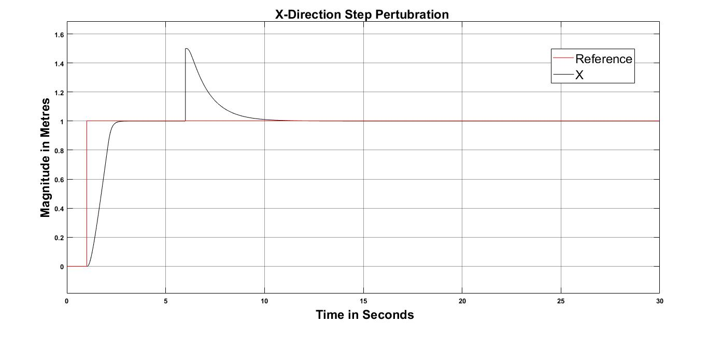
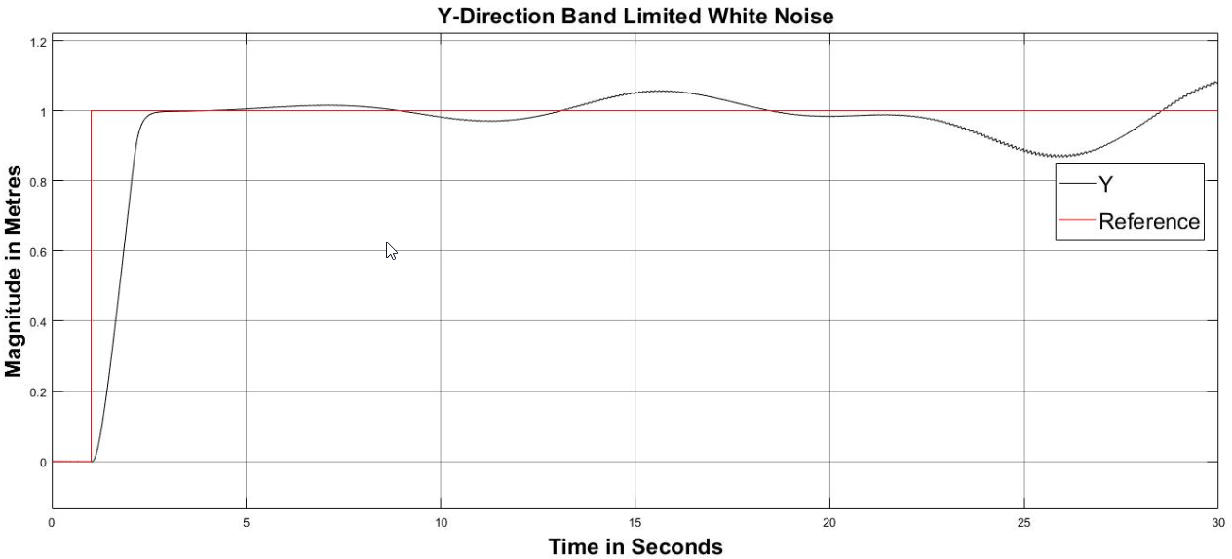
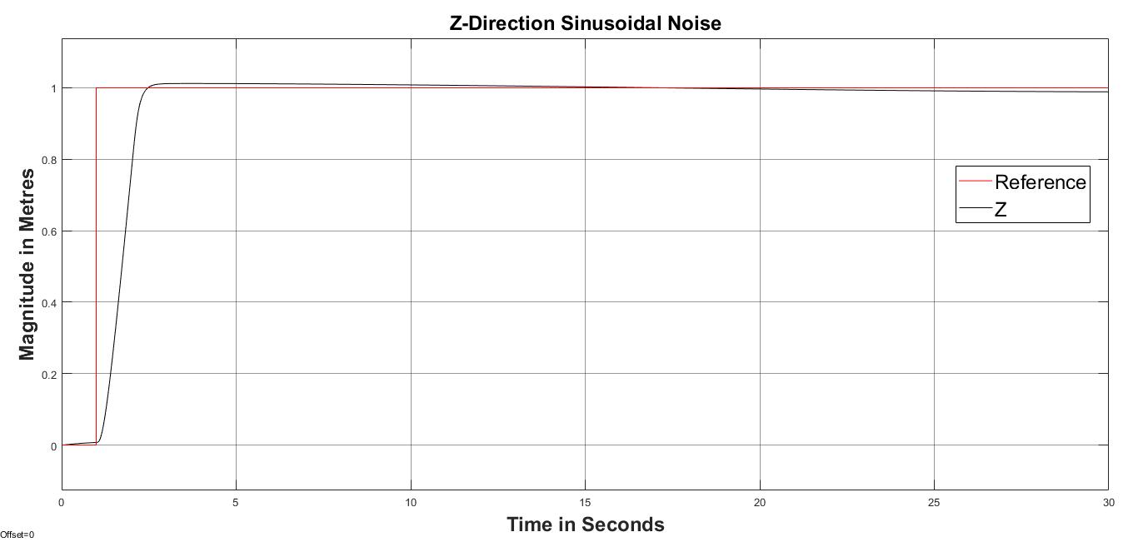
Response with MPC for various perturbations
3 different kinds of perturbations were implemeted on 3 different axes of simplified drone model and run separately.
MPC was able to handle perturbations of different types (step, sinusoidal and band-limited white noise).

Slide 6

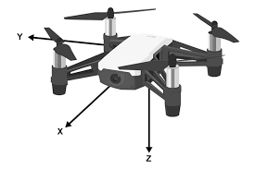
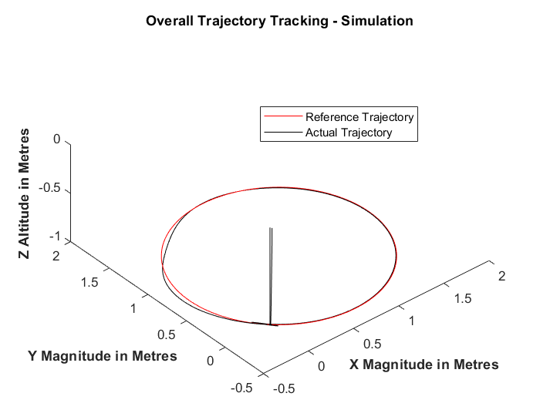
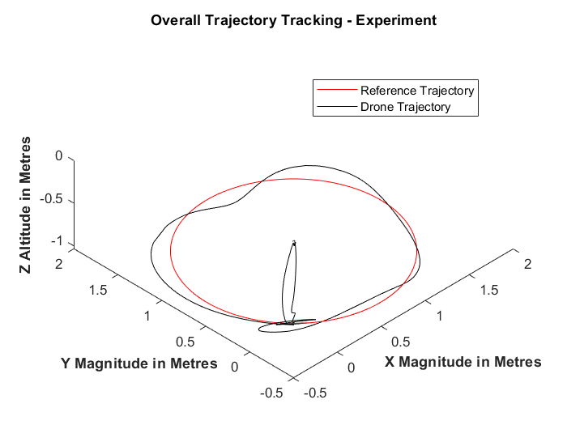
MPC SimoDrone - Trajectory Tracking
Overall Performance index
(Root Mean Square Error) = 0.3
Overall Performance index
(Root Mean Square Error) = 0.95

Slide 7
Lessons Learnt
MPC capable of rejecting perturbations.
MPC provided good simulation results but performed poorly on the drone.
High computational time due to large prediction horizon
Uncertainties in the system and unmodelled dynamics
Need arises for approaches to improve robustness.

Slide 8
Control and AI – MPCs and Markov Decision Processes (MDP)
Comparison of MPC and MDP frameworks
Markov Decision Process (MDP)
Why the AI Approach?
(Previous Semester)

Slide 9

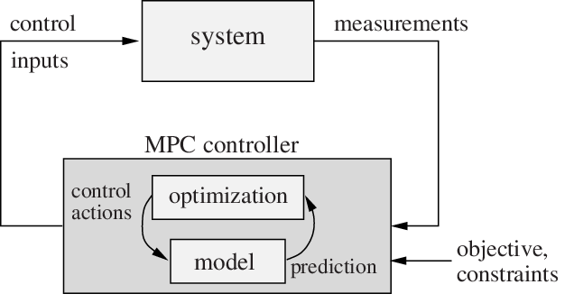
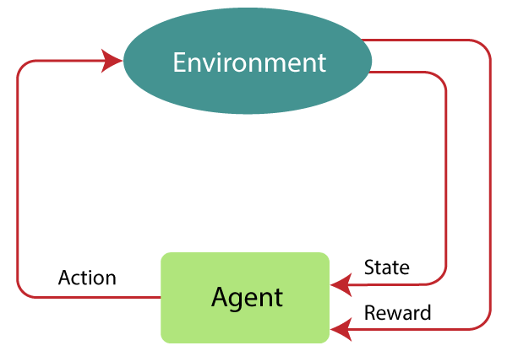
Comparison of MPC and MDP frameworks
Model Predictive Control (MPC) | Markov Decision Process (MDP)
Controller | Agent
System | Environment
Control Input | Actions
Measurements/State | State
Objective/Constraints | Rewards
Common Finite Horizon approach

Slide 10
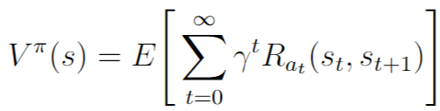
Markov Decision Process (MDP)[Kolobov, A. (2012)]
Consider a discrete system where all states are available (observable) at any given point of time. Then a Markov Decision Process is a tuple (S, A, D, T, R) where –
S is the finite set of possible states of the system i.e., the state space
A is the set of actions
D are the time steps at which the action should be taken
T : S × A × S × D → [0, 1] is a transition function mapping the probability of T (s1, a, s2, t) of going to state s2 if action a is executed in state s1 at time t
R : S × A × S × D → R is a reward function giving a reward R(s1, a, s2, t) of going to state s2 if action a is executed in state s1 at time t
The goal is to minimize the expected accumulated costs or, equivalently, to maximize the expected accumulated rewards.
Value - The Value of a state s under a policy π is the total expected cost, starting in s before it reaches a goal g ∈ G
where γ is the discount factor and γ = 1 for a finite-horizon MDP.
Notes:
The vf desirability of being in a state s as it represents the expected accumulated costs. The objective of mdp is to minimize the value

Slide 11
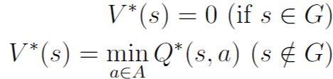
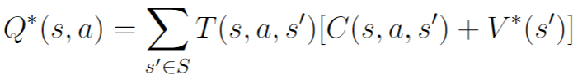
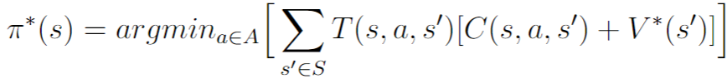
Markov Decision Process (MDP)[5]
Optimal Value and Policy – The optimal Value of a state s is given by
Where the optimal Q value is given by -
Therefore, the optimal policy π∗(s) is defined as -

Slide 12

Why an AI approach to the problem?
Robust Model Predictive Control (MPC) | Markov Decision Process (MDP)
Conservative robust solutions – Uncertainty information not used[Campo, P.J, Et all (1987)]. | Use available information on uncertainties and perturbations through probability transitions
High computational time, implementation issues[Cannon, M., Et all(2008)]. | On-line algorithms designed to operate in real bounded time.
Linearization of Model – Simplifications assumed | Non-linearities and saturations handled easily.

Slide 13
Trial-based Heuristic Tree Search (THTS)
Introduction
Heuristics and Cost function
Contraction of Action Space
Cost Aggregation
THTS Implementation
UAV equations of motion

Slide 14
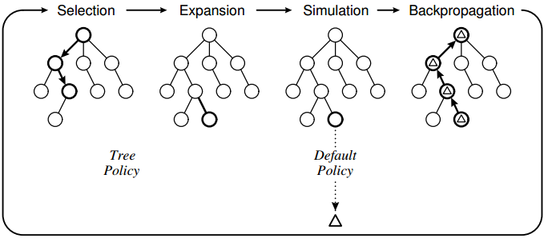
Introduction
Previous Model
Trial-based Heuristic tree search (THTS) is a kind Monte Carlo Tree Search Algorithm implementing heuristics.
The THTS algorithm employs a rollout-based approach, where the transition probabilities P(s'|s,a) are calculated on the go with the Q-values Q(s,a) and Values V(s) and converges to the exact probabilities over time.
New Model
Reuse of previously calculated states.
Over time, the tree can turn into a graph.
Horizon Bigger than base horizon

Slide 15
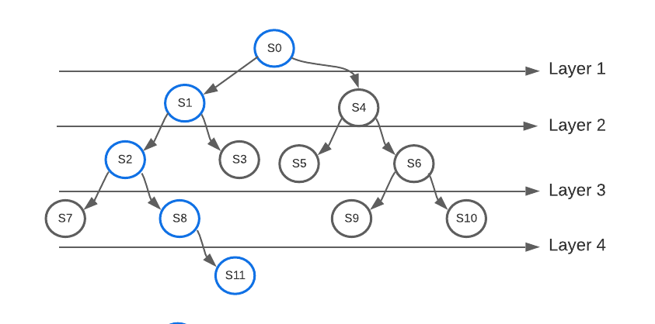
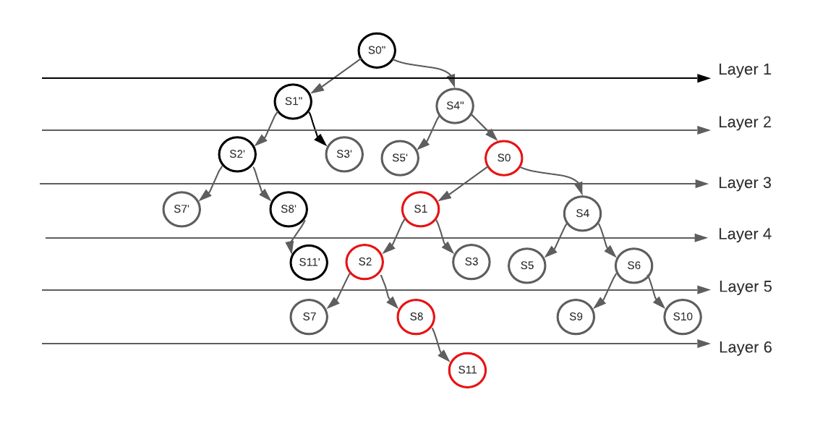
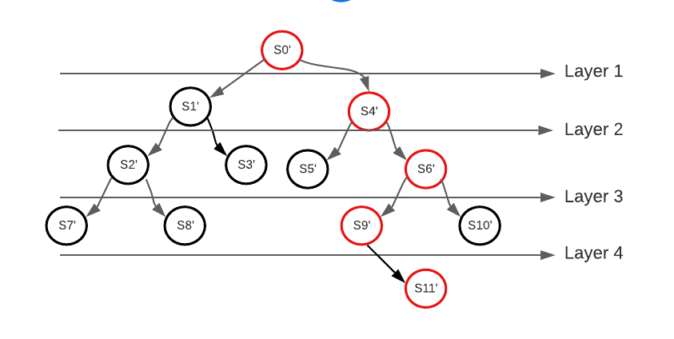
Introduction

Slide 16
Heuristics and Cost Function
Heuristics function helps to guide the algorithm towards the desired goal quickly for faster convergence.
Square of the Euclidean distance between the current position and the desired position at a time t was implemented as the Heuristic H(s,t).
Time dependency arises because in the case of trajectory tracking the goal changes over time
$$H\left(s,t\right)={\left(x_{pos}\left(t\right)−x_{pos−ref}\left(t\right)\right)}^{2}$$
A cost function C(s,t) was thus employed taking the weighted sum of the squared error of the desired position (goal) and velocity.
$$C\left(s,t\right)={\left(x_{pos}\left(t\right)−x_{pos−ref}\left(t\right)\right)}^{2}+αx_{vel}^{2}$$

Slide 17
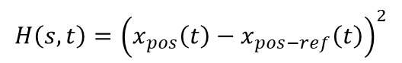

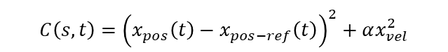
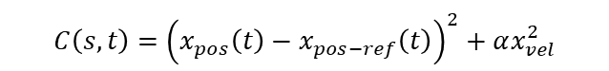
Heuristics and Cost Function
Previous Model
New Model
$$H\left(s,t\right)={\left(x_{pos}\left(t\right)−x_{pos−ref}\left(t\right)\right)}^{2}$$
$$C\left(s,t\right)={\left(x_{pos}\left(t\right)−x_{pos−ref}\left(t\right)\right)}^{2}+αx_{vel}^{2}$$
$$C\left(s,t\right)={\left(x_{pos}\left(t\right)−x_{pos−ref}\left(t\right)\right)}^{2}+αx_{vel}^{2}$$
$$H\left(s,t\right)=C\left(s,t\right)$$

Slide 18
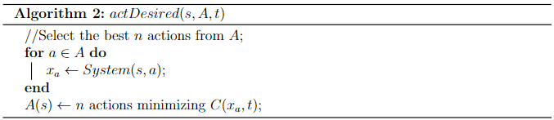
Contraction of the Action Space
For example, if a user defines n=5 where there are 20 possible actions, only the best 5 actions will be chosen to be played in the tree using the actDesired function.

Slide 19
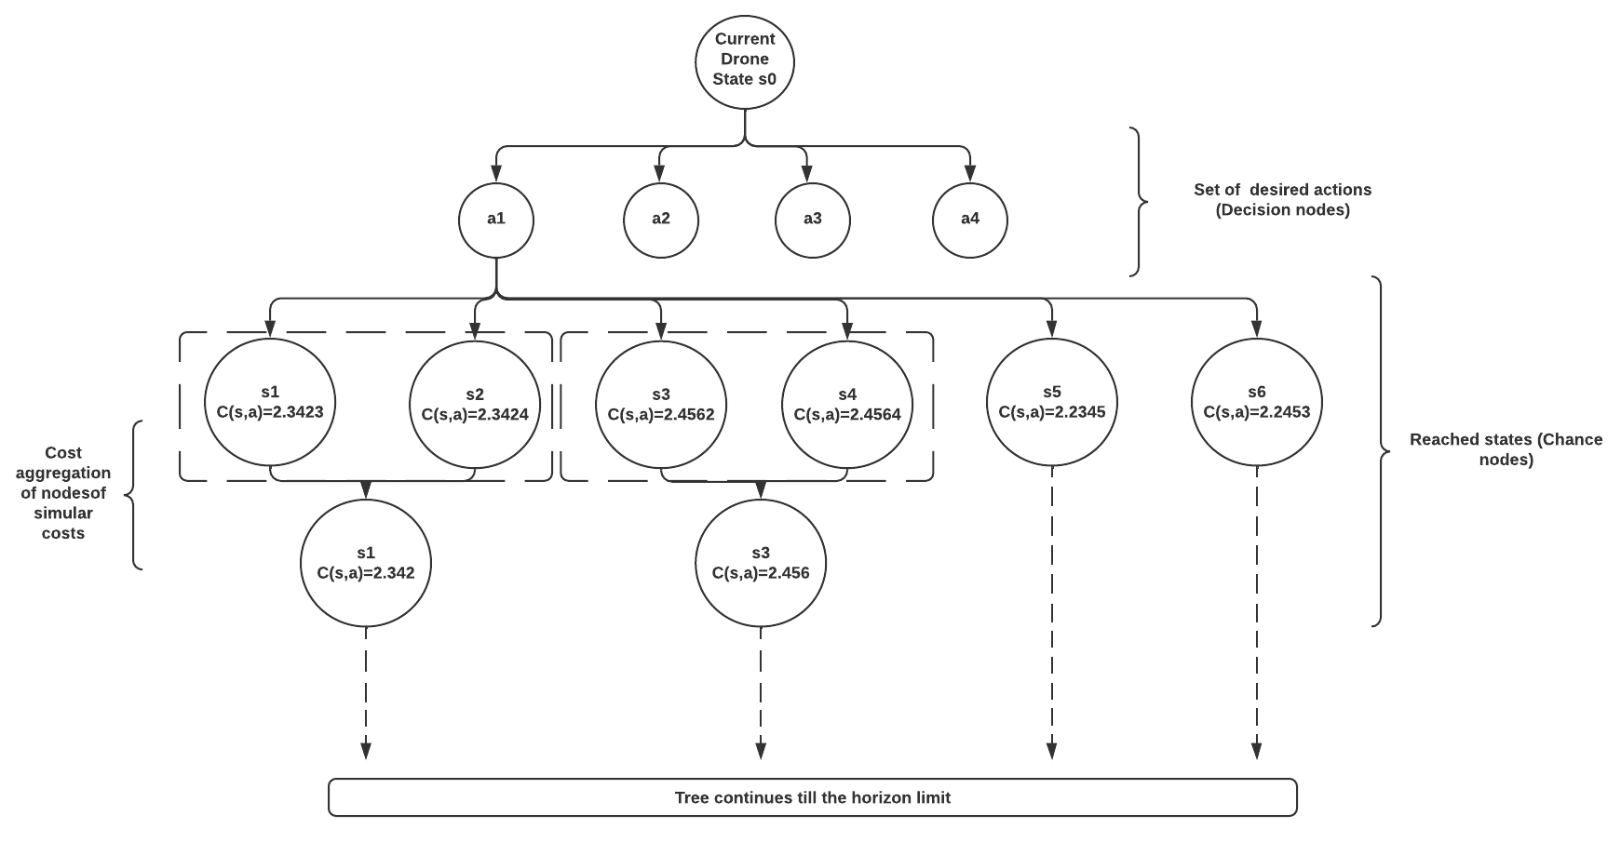
Cost Aggregation
d=3
To tackle the issues arising with high stochastic branching factors, states with similar costs are considered as one aggregated state.
The nodes were thus accumulated if they existed within a user-defined decimal bound d of an already existing child node s′ ∈ child(s, a)

Slide 20
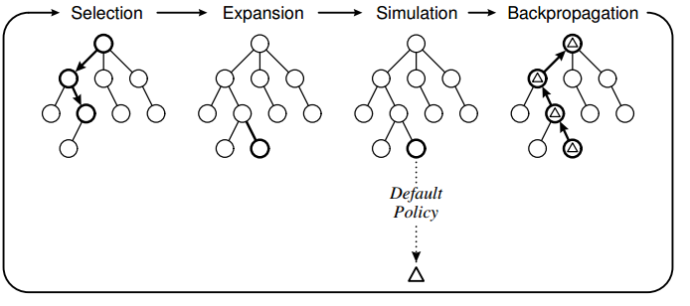
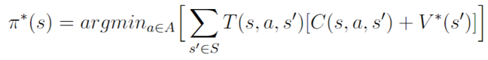

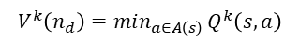
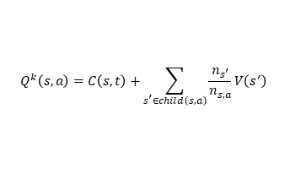
THTS Implementation
Play best action in a node to go to the next node/state
Create new node if the state has not been reached before
Assign heuristics
Simulate till end of horizon
$$Q^{k}\left(s,a\right)=C\left(s,t\right)+\sum_{s^{′}∈child\left(s,a\right)}{\frac{n_{s^{′}}}{n_{s,a}}V\left(s^{′}\right)}$$
$$V^{k}\left(n_{d}\right)=min_{a∈A\left(s\right)} Q^{k}\left(s,a\right)$$
Monte Carlo and Bellman Backup
Update counters
$$V^{k}\left(n_{d}\right)=H(s,t)$$

Slide 21
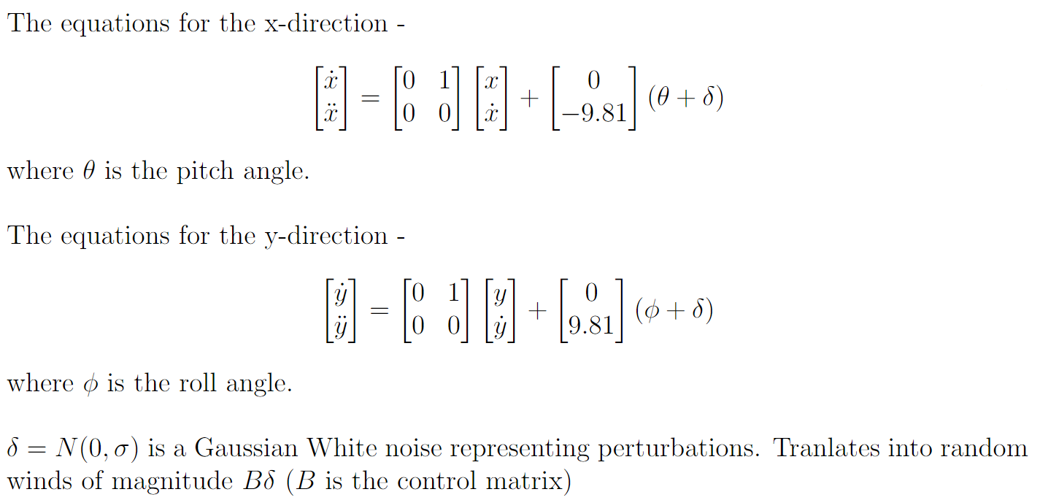
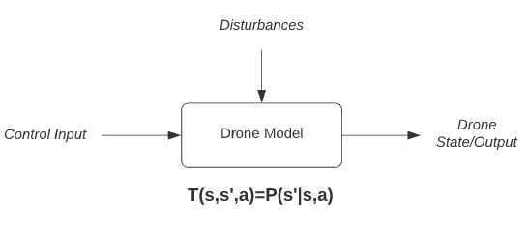
UAV Equations of motion
Saturation of 0.2 radians for both the pitch and roll angle.

Slide 22
Results and Analysis
Benchmarking
Study on cost function parameter α
Study on cost aggregation parameter d
Relative state
Study on trials
Trajectory tracking – 1D
Unitary Step
Ramp
Bell Curve
Trajectory tracking – 2D
Circular Trajectory (x & Y Directions)

Slide 23
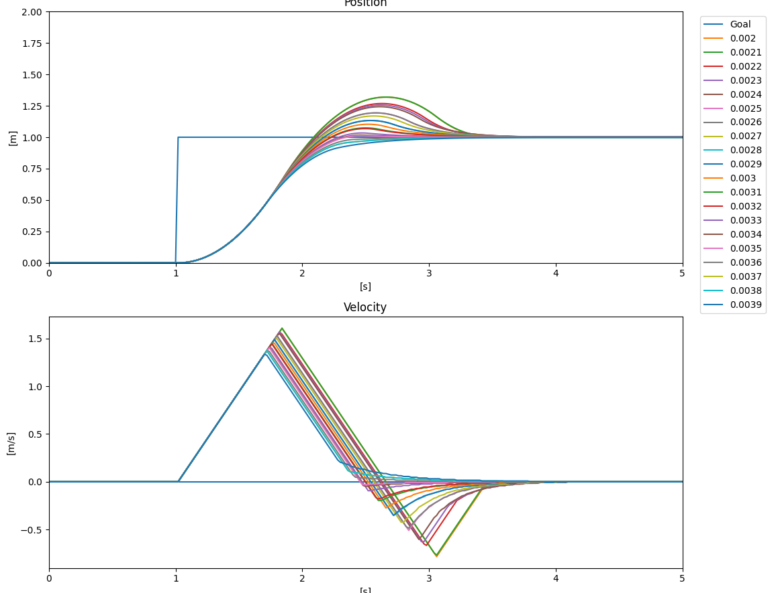

Study on cost function parameter α
The empirical study revealed a value of α = 0.0035 to give a critically damped response.
$$C\left(s,t\right)={\left(x_{pos}\left(t\right)−x_{pos−ref}\left(t\right)\right)}^{2}+αx_{vel}^{2}$$
Notes:
Similar to the RTDP, the damping of the system response is dependent on the weighing parameter α that is utilized in the cost function.
The parametric study revealed a value of α = 0.035 to give a critically damped response, exactly like RTDP.

Slide 24
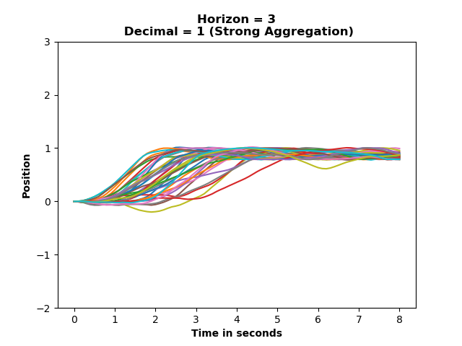
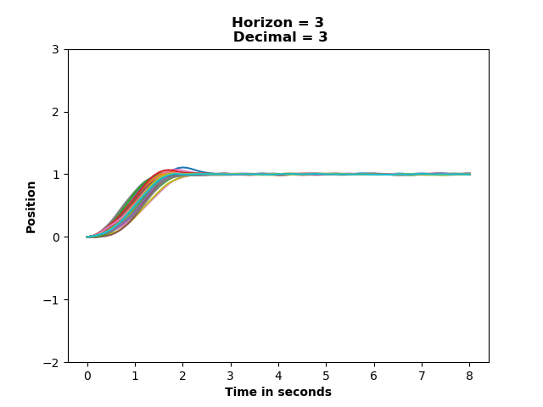
Study on cost aggregation parameter d
Strong aggregation leads to loss of information about other states.
Trade-off in reduction of states and loss of information, leading to a compromise between run-time and performance for the controller.
Notes:
Although stronger cost aggregation is preferred due to the reduction of the number of states in the tree, it is observed that for d=1 (strong aggregation), the performance is degraded.
Strong aggregation leads to loss of information about other states.
There is a compromise between reducing the number of states and loss of information, leading to a compromise between run-time and performance for the algorithm.
d=3 was found to be optimal.

Slide 25
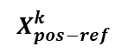
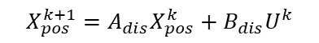
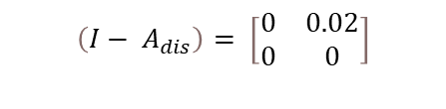
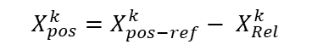
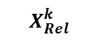
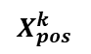
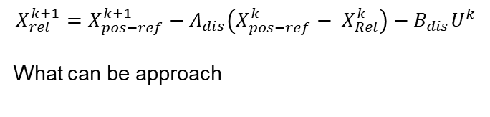
New proposed aggregation
Previous Discrete model
The state will be the error!!!
$$X_{pos}^{k+1}=A_{dis}X_{pos}^{k}+B_{dis}U^{k}$$
$$\left(I− A_{dis}\right)= \left[\begin{matrix}0 & 0.02 \\ 0 & 0\end{matrix}\right]$$
$$C\left(s,t\right)={\left(x_{pos}\left(t\right)−x_{pos−ref}\left(t\right)\right)}^{2}+α{\left(v_{pos}\left(t\right)−v_{pos−ref}\left(t\right)\right)}^{2}$$
New Discrete model
$$X_{pos}^{k}$$
$$X_{rel}^{k+1}=X_{pos−ref}^{k+1}−A_{dis}\left(X_{pos−ref}^{k}− X_{Rel}^{k}\right)−B_{dis}U^{k}$$
What can be approach
$$X_{Rel}^{k}$$
$$X_{rel}^{k+1}=\left(I− A_{dis}\right)X_{pos−ref}^{k}+A_{dis} X_{Rel}^{k}−B_{dis}U^{k}$$
$$X_{pos−ref}^{k}$$
$$C\left(s,t\right)={\left(x_{rel}\left(t\right)\right)}^{2}+αv_{rel}^{2}(t)$$
$$X_{pos}^{k}=X_{pos−ref}^{k}− X_{Rel}^{k}$$
Notes:
Although stronger cost aggregation is preferred due to the reduction of the number of states in the tree, it is observed that for d=1 (strong aggregation), the performance is degraded.
Strong aggregation leads to loss of information about other states.
There is a compromise between reducing the number of states and loss of information, leading to a compromise between run-time and performance for the algorithm.
d=3 was found to be optimal.

Slide 26
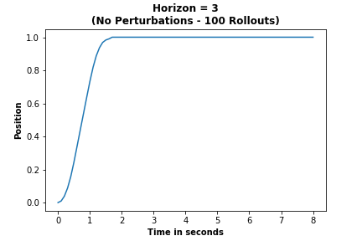
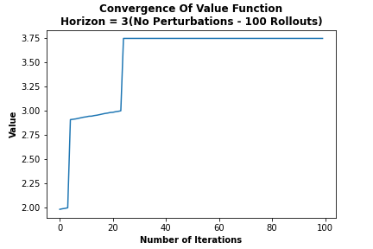
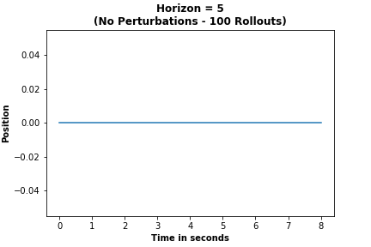
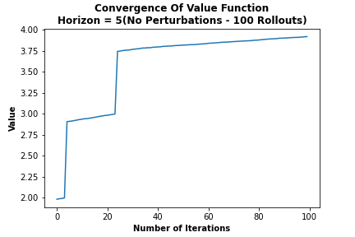
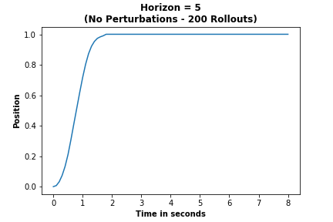
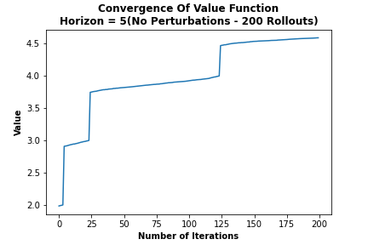
Study on trials
Increase in the horizon leads to better performance, but more trials are required to reach convergence of the Value function and the optimal policy.
Notes:
It was observed that for higher horizon values, more number of trials were required in order to attain Value convergence.
Eg – Horizon = 5 does not converge at 100 trials, but at 200 trials.
Thus, an increase in the horizon can lead to better performance, but more trials are required to reach convergence of the Value function and the optimal policy.

Slide 27
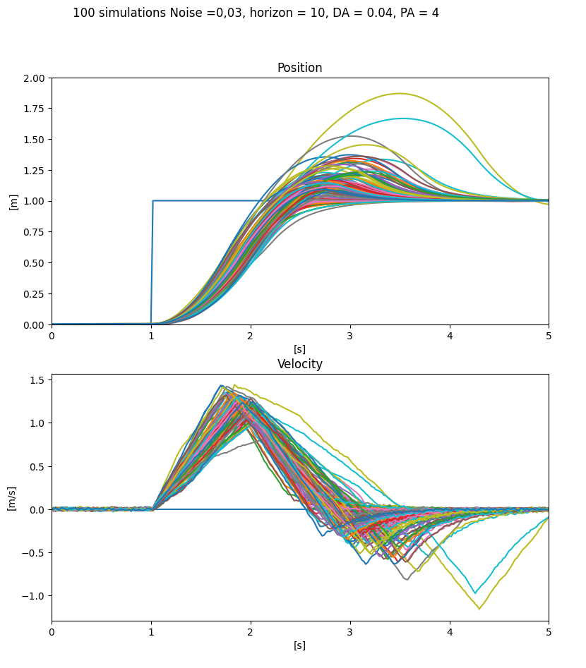
Simulated Trajectories for Unitary Step

Slide 28
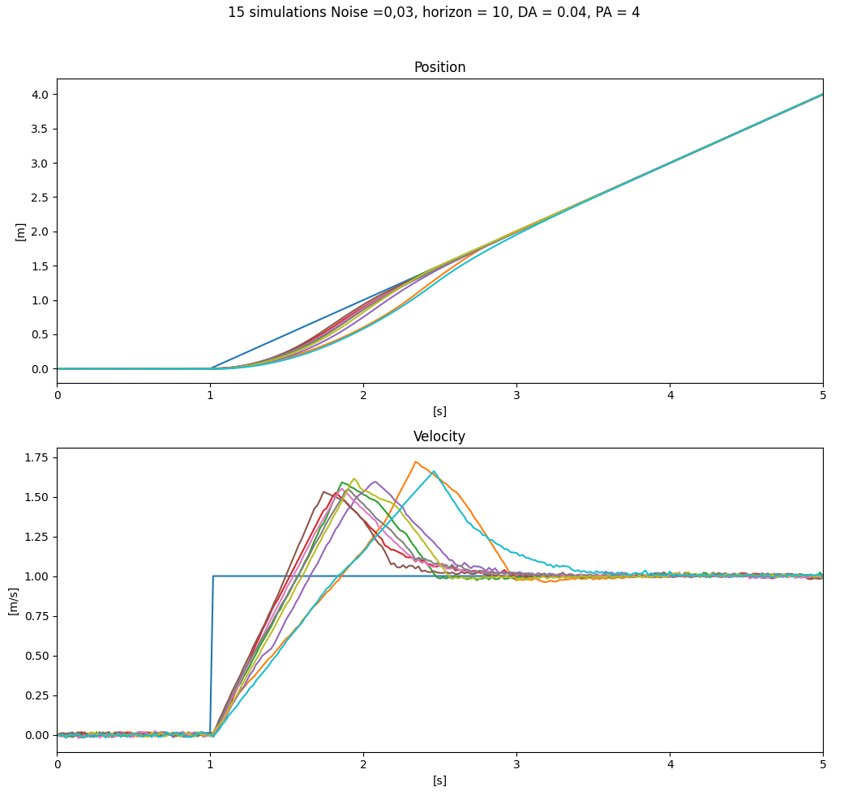
Simulated Trajectories for Ramp

Slide 29
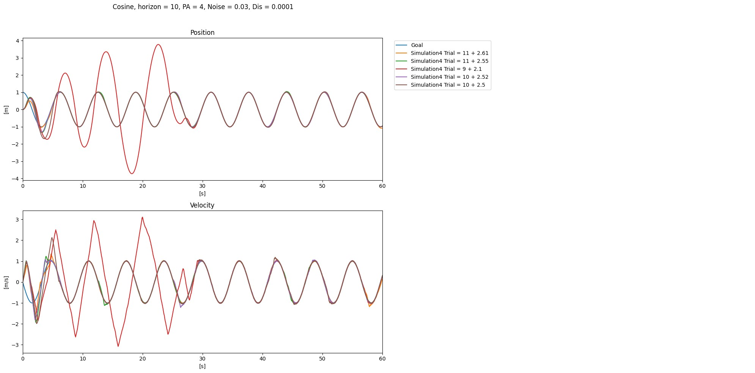
Simulated Trajectories for Cosines

Slide 30
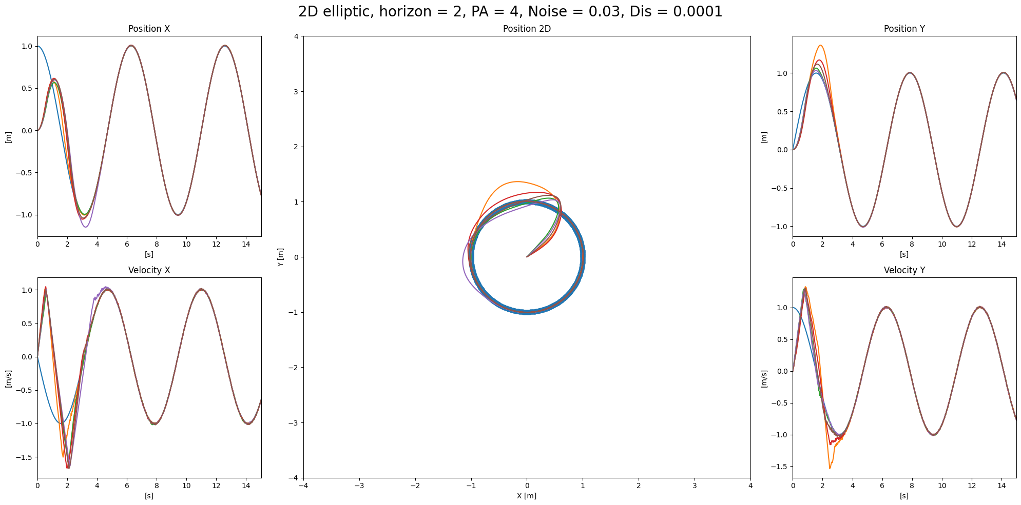
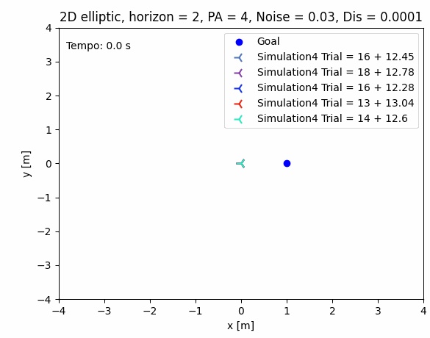
Simulated Trajectories 2D for a circular path (Coupled)

Slide 31
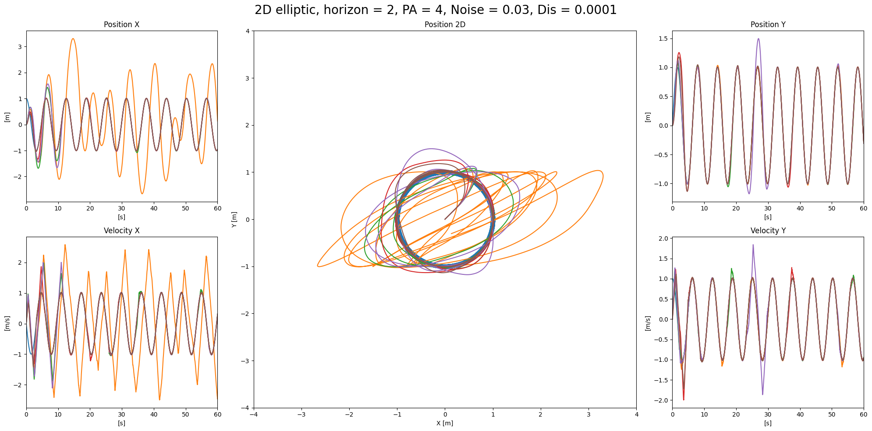
Simulated Trajectories 2D for a circular path (Uncoupled)
double cost_function(const Eigen::VectorXf& x){
double a =x(0)*x(0) + 0.0035*x(1)*x(1);
return a;
}

Slide 32
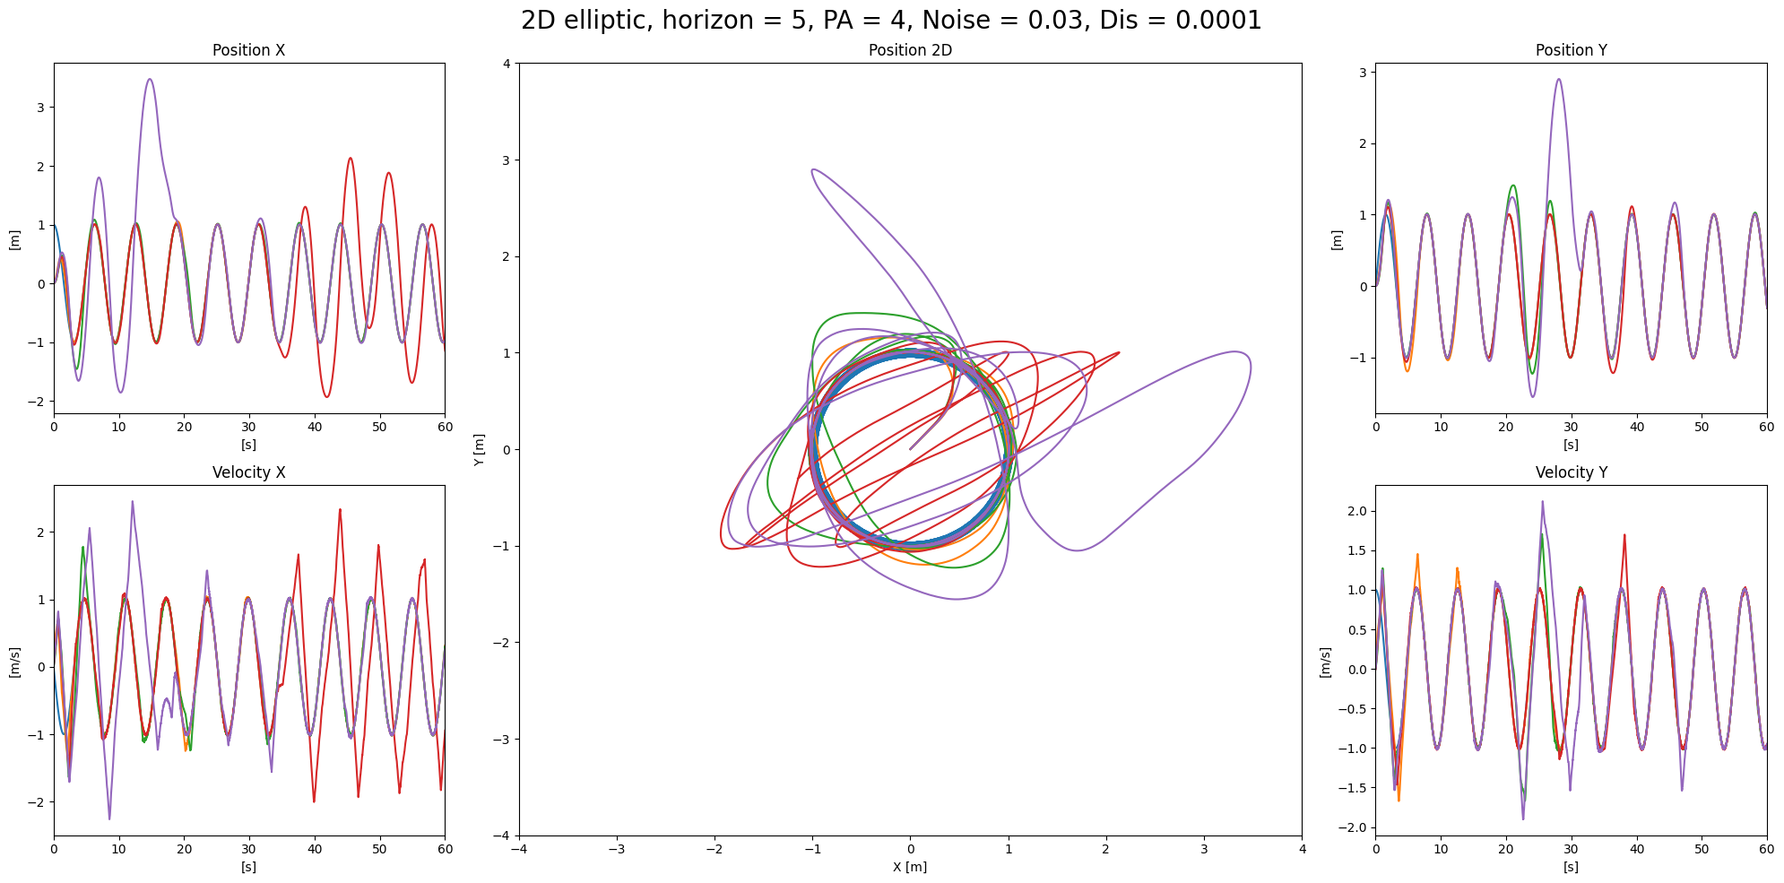

Simulated Trajectories 2D for a circular path (Uncoupled)
double cost_function(const Eigen::VectorXf& x){
double a =x(0)*x(0) + 0.0035*x(1)*x(1);
if(abs(x(1))*0.0001 > 0.5 ){
return a*30;
}else{
return a;
}
}

Slide 33
Conclusion and Perspectives
Outcomes
Issues to tackle
Proposed future work
Alternate research paths

Slide 34
Outcomes
Representation of a MPC control problem in the probabilistic MDP framework.
Deriving the Heuristic and Cost functions for the THTS algorithm.
Implementation of THTS algorithm on a simplified UAV Model.
Path tracking ability of the MDP controller was verified.
Implementation in C++ which allows online optimization on the drone.
Notes:
Representation of a MPC control problem in the probabilistic MDP framework.
A classical MPC control problem was represented in the probabilistic MDP framework. This enabled the inclusion of perturbation and uncertainty information in the design process to determine the control input, or in the case of MDP, an optimal policy.
RTDP and THTS algorithms were implemented to design a controller for the simplified UAV Model.
Parametric study showed the effects of perturbations, horizon and number of trials on the performance of the controller.
Robustness study validated the robustness of the MDP controller supporting the idea of using MDPs to create Robust MPCs.
Trajectory tracking for various 1D and 2D trajectories in the presence of perturbations were satisfactory, showing the path tracking capability of the MDP controller.
While only 1 RTDP trial could be run between 0.1 to 0.2 seconds, about 100 trials could be run with the THTS code between 0.1 to 0.2 seconds.

Slide 35
Issues to tackle
The sluggish response of the MDP controller may not satisfy real world requirements in certain cases and thus needs to be studied.
A constraint on states can improve the performance of the optimization.
The use of graphs instead of trees can create a kind of memory, which must be verified.

Slide 36
Proposed future work
Study on the use of state restrictions.
Constant Restrictions
Dynamic Restrictions
Development of a model where the node key takes into account the speed of the reference.
Analyse on the influence of reference speed on optimization.
Real time testing on the UAV with and without disturbances to validate robustness results obtained through simulations

Slide 37
Bibliography
[1] Kolobov, A. (2012). Planning with markov decision processes: An AI perspective. Synthesis Lectures on Artificial Intelligence and Machine Learning, 6(1):1–210.
[2] Campo, P. J. and Morari, M. (1987) ‘Robust Model Predictive Control.’, Proceedings of the American Control Conference, pp. 1021–1026. doi: 10.1007/978-1-4471-5102-9_2-3.
[3] Cannon, M., Kouvaritakis, B. and Wu, X. (2008) Probabilistic constrained MPC for systems with multiplicative and additive stochastic uncertainty, IFAC Proceedings Volumes. IFAC. doi: 10.3182/20080706-5-kr-1001.02587.

Slide 38
Bibliography
[1] Campo, P. J. and Morari, M. (1987) ‘Robust Model Predictive Control.’, Proceedings of the American Control Conference, pp. 1021–1026. doi: 10.1007/978-1-4471-5102-9_2-3.
[2] Cannon, M., Kouvaritakis, B. and Wu, X. (2008) Probabilistic constrained MPC for systems with multiplicative and additive stochastic uncertainty, IFAC Proceedings Volumes. IFAC. doi: 10.3182/20080706-5-kr-1001.02587.
[3] Farina, M. et al. (2014) ‘Output feedback model predictive control: A probabilistic approach’, IFAC Proceedings Volumes (IFAC-PapersOnline), 19, pp. 7461–7466. doi: 10.3182/20140824-6-za-1003.02283
[4] D.P. Bertsekas, Distributed dynamic programming, lEEE Trans. Autom. Control 27 ( 1982) 6 I O-6 16.
[5] Kolobov, A. (2012). Planning with markov decision processes: An AI perspective. Synthesis Lectures on Artificial Intelligence and Machine Learning, 6(1):1–210.
[6] Barto, A. G., Bradtke, S. J. and Singh, S. P. (1995) ‘Learning to act using real-time dynamic programming’, Artificial Intelligence, 72(1–2), pp. 81–138. doi: 10.1016/0004-3702(94)00011-O.
[7] Li, Lihong & Walsh, Thomas & Littman, Michael. (2006). 'Towards a Unified Theory of State Abstraction for MDPs'. Proceedings of the Ninth International Symposium on Artificial Intelligence and Mathematics.

